Slide 1
Proyecto Integrador Modelado de Movie_dataset.csv
Por: Francisco González

Slide 2
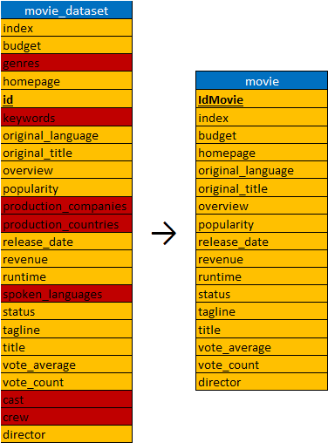
Normalización y Dependencias Funcionales

Slide 3
Primera forma normal

Slide 4



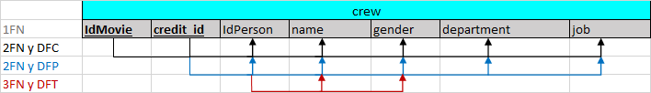



Segunda y Tercera forma normal

Slide 5
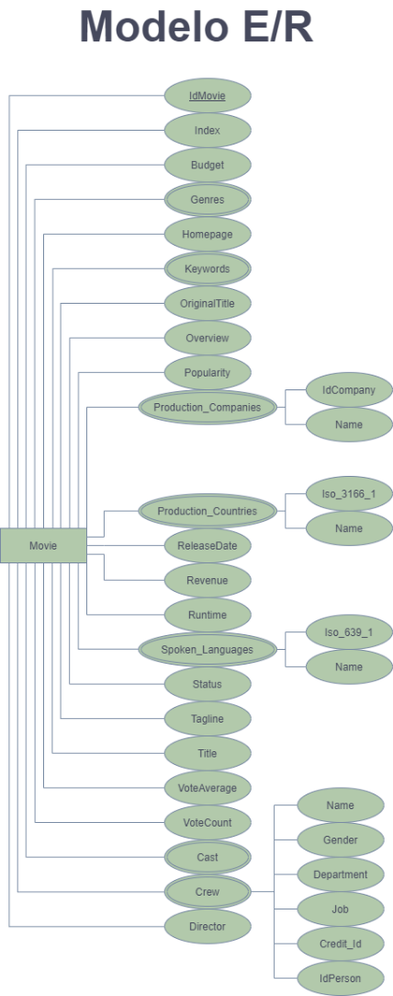
Modelo Entidad-RELACIÓN

Slide 6
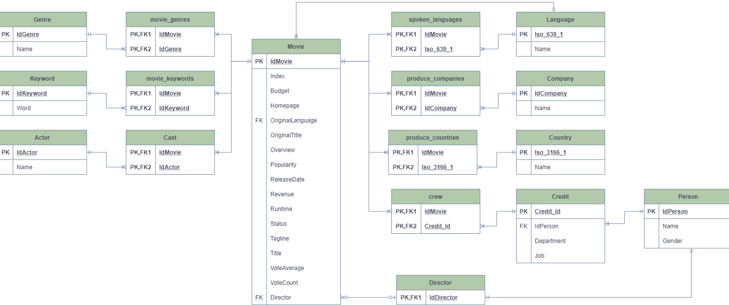
Modelo Relacional

Slide 7
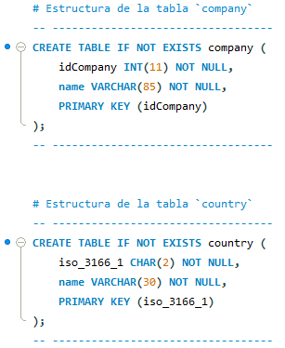
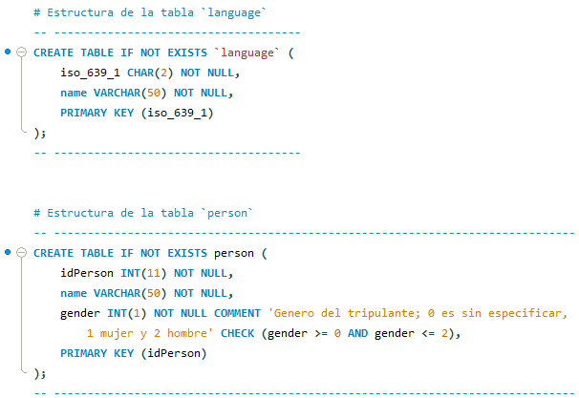
DDL – Tablas Fuertes de campos multivaluados y compuestos

Slide 8
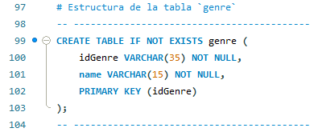
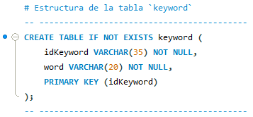
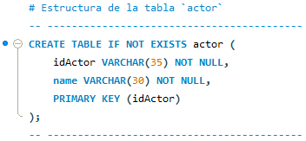
DDL – Tablas Fuertes de campos multivaluados

Slide 9
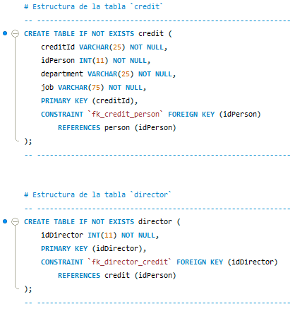
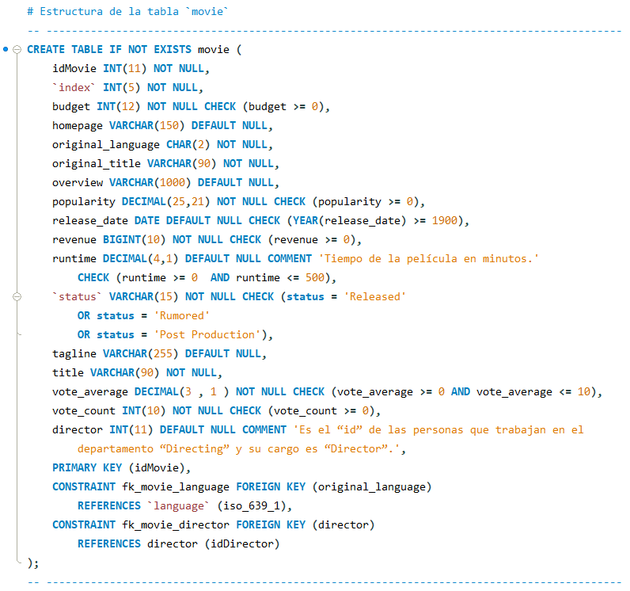
DDL – Tablas Débiles

Slide 10
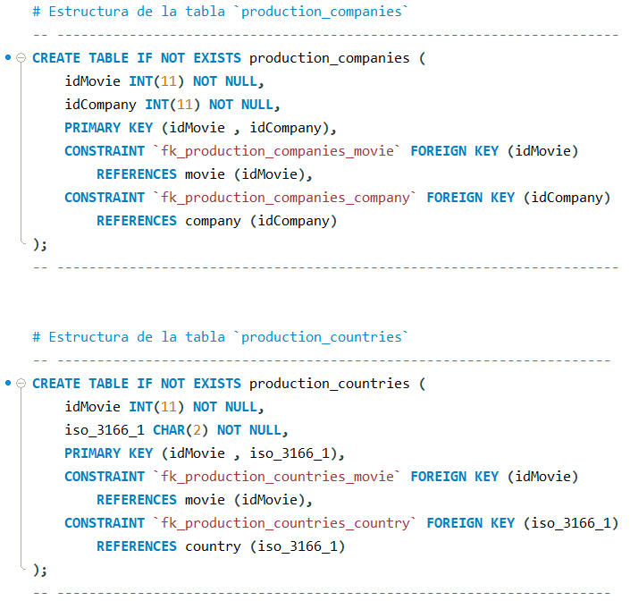
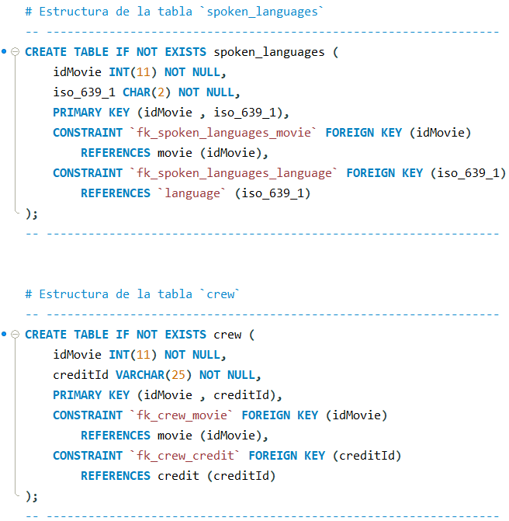
DDL – Tablas de las RELACIONES MUCHOS A MUCHOS

Slide 11
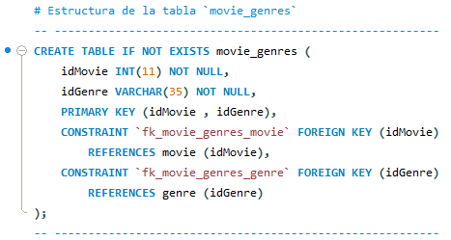
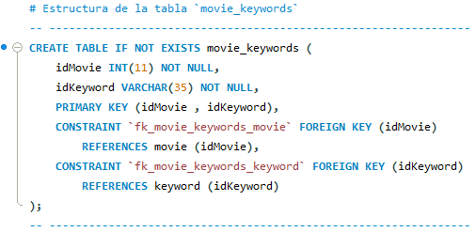
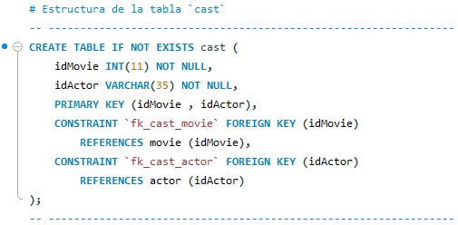
DDL – Tablas de las relaciones m:n de los campos multivaluados

Slide 12
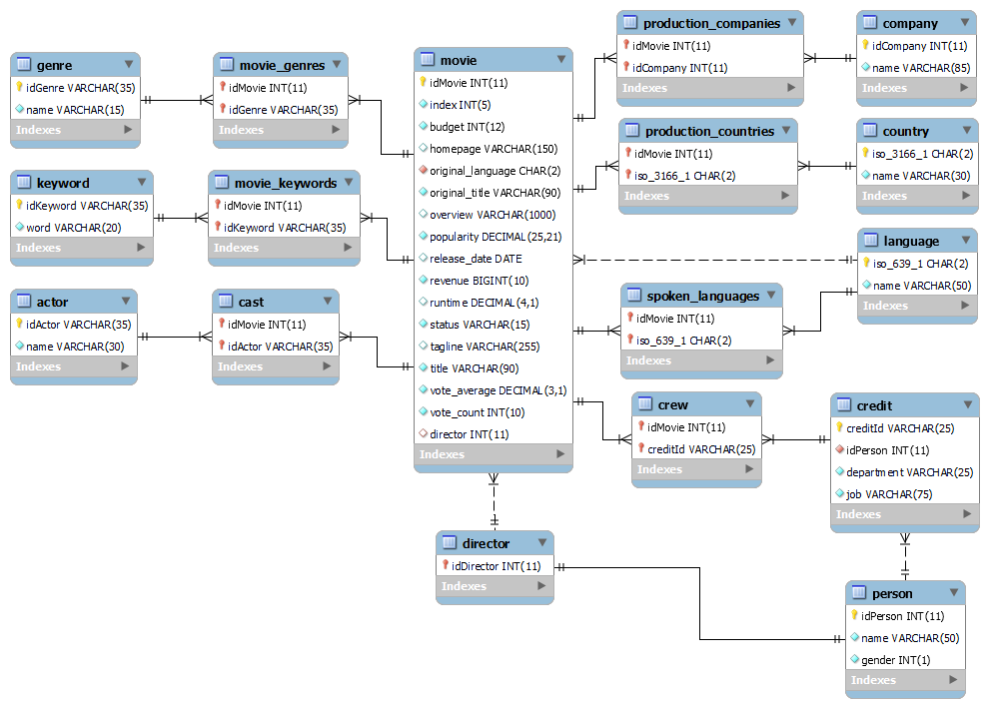
Modelo Relacional de Mysql workbench

Slide 13
Población de las tablas Relacionales
DROP PROCEDURE IF EXISTS Json2Relational_tabla; DELIMITER // CREATE PROCEDURE Json2Relational_tabla() BEGIN DECLARE i INT DEFAULT 0; CREATE TABLE tmp_tabla(IdMovie INT, `Atributo2` DOMIIO, `Atributo3` DOMIIO, ... , `AtributoN` DOMIIO); WHILE i <= ? DO
INSERT INTO tmp_tabla SELECT id AS idMovie, JSON_EXTRACT(`atributo_multivaluado`, CONCAT("$[",i,"]. `Atri_Int` ")) AS `Atributo2`, REPLACE(JSON_EXTRACT(`atributo_multivaluado`, CONCAT("$[",i,"]. `Atri_Varchar` ")), """", "") AS `Atributo3` FROM movie_dataset_cleaned WHERE id IN (SELECT id FROM movie_dataset_cleaned WHERE i <= JSON_LENGTH(`atributo_multivaluado`)); SET i=i+1; END WHILE; DELETE FROM tmp_table WHERE id IS NULL; END // DELIMITER ;
DROP PROCEDURE IF EXISTS Json2Relational_tabla; DELIMITER // CREATE PROCEDURE Json2Relational_tabla() BEGIN DECLARE i INT DEFAULT 0; CREATE TABLE tmp_tabla(IdMovie INT, `Atributo2` VARCHAR(?), `Atributo3` VARCHAR(?)); WHILE i <= ? DO
INSERT INTO tmp_tabla SELECT id AS idMovie, md5(JSON_EXTRACT(CONCAT('["', REPLACE(`atributo_multivaluado`,, ' ', '","'), '"]’), CONCAT("$[",i,"]"))) AS `Atributo2`, JSON_EXTRACT(CONCAT('["', REPLACE(`atributo_multivaluado`,, ' ', '","'), '"]’), CONCAT("$[",i,"]")) AS `Atributo3` FROM movie_dataset_cleaned WHERE id IN (SELECT id FROM movie_dataset_formatted WHERE i <= JSON_LENGTH(CONCAT('["', REPLACE(`atributo_multivaluado`,, ' ', '","'), '"]’), )); SET i=i+1; END WHILE; DELETE FROM tmp_table WHERE id IS NULL; END // DELIMITER ;

Slide 14

Población de las tablas Finales y de relación
INSERT INTO `tabla final` SELECT DISTINCT `Atributo2`, `Atributo3`, … `AtributoN` FROM `tmp_tabla`;
INSERT INTO director SELECT DISTINCT IdCrew FROM tmp_crew WHERE department = "Directing" AND job = "Director";

Slide 15
Población de las tabla Movie
INSERT INTO movie SELECT * FROM ( SELECT DISTINCT id, `index`, budget, IF(homepage != "", homepage, NULL), original_language, original_title, IF(overview != "", overview, NULL), popularity, IF(release_date != "", release_date, NULL), revenue, runtime, `status`, IF(tagline != "", tagline, NULL), title, vote_average, vote_count, IF(director != "", tc.idCrew, NULL) idDirector FROM movie_dataset_cleaned m LEFT JOIN tmp_crew t ON (m.director = t.name) WHERE tc.job = "Director“ ) t WHERE idDirector NOT IN (1009253, 930212) OR idDirector IS NULL ;

Slide 16
¡GRACIAS! ☺

